Slide 1
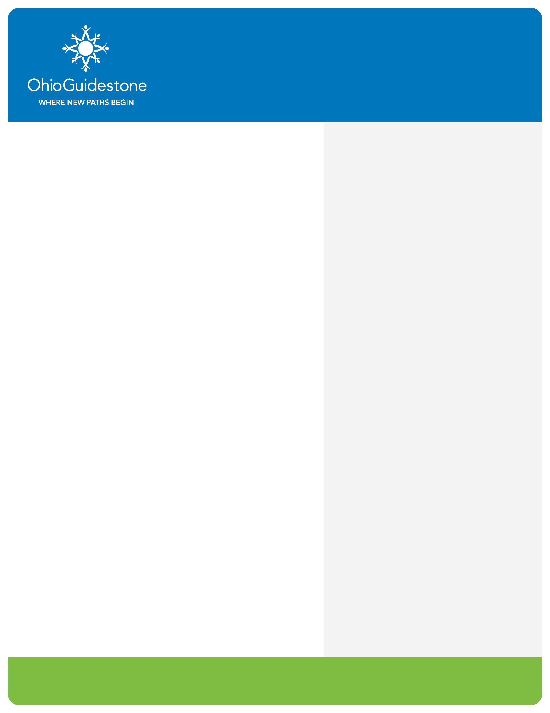
Project Direct Link (PDL)
What is it?
How Can it Help?
Project Direct Link is a program designed to provide Medicated Assisted Treatment (Vivitrol) to individuals in custody at the Lucas County Corrections Center or Correctional Treatment Facility.
Individuals receive a comprehensive diagnostic assessment to determine if they meet criteria for behavioral health treatment
Individuals will be linked to treatment options in their community
An engagement specialist will continue to follow up with the client for support and assistance
Individuals will receive medication (Vivitrol) to assist with reducing cravings for opiates as they are being linked to treatment resources.
Who May Qualify?
Adults with a history of or recent use of opiates who:
  Have active insurance or are eligible to obtain insurance
  Are a resident of Lucas, Defiance, Henry, Williams or Fulton County
  Have a release date from incarceration with no holders
How Clients get Started?
Referral sources can complete the Project Direct Link Referral Sheet and follow instructions at the bottom of the page to return to the appropriate person
For Information
Marvin Houston, Clinical Supervisor
mhouston@arenewedmindservices.org
www.OhioGuidestone.org

